Slide 1
School Memories
Unit 10(G8B) & Unit14 (G9)
No.28 Middle School
Wang Weiwei

Slide 2
8B Unit10 I’v had this bike for three years.
(possessions)
School
Memories
G9 Unit 14 I remember meeting all of you in grade 7.
(persons & experiences)

Slide 3
Read and translate
1.The toy bear has left many soft and sweet memories in my heart since I got it.
2. My daughter was more understanding, although she felt sad to part with certain toys.
3. It has special meaning to me because Grandma gave it to me.
4.We are considering having a yard sale to sell the old things that don’t fit us anymore.
5.I always did my homework carefully to meet his standards.

Slide 4
Read and translate
6. Not only did he guide me to do a lot better in science, but also he always took the time to explain things to me clearly.
7. She was always patient with me whenever I couldn’t understand anything.
8. She helped me work out the answers myself no matter how difficult they were.
9. Thanks to her, I put in more effort and my exam scores doubled.
10. I take the pride of long hours of training and overcoming fear.

Slide 5
Exercises:
until
time explaining to me ______I understood completely.Thanks _____ them, I’ ve become interested in English and I’m good at it now! I’m so lucky to be a member of them. I think we should be thankful to the important people in our lives who helped and _________ us ---- our parents, our teachers and our friends. From now on, I’ll try to help others when they are in trouble. Now it’s time to say goodbye. I will remember my life in junior high school forever.
to
5
4
10
3
2
9
1
8
7
6
supported

Slide 6
Exercises:
until
time explaining to me ______I understood completely.Thanks _____ them, I’ ve become interested in English and I’m good at it now! I’m so lucky to be a member of them. I think we should be thankful to the important people in our lives who helped and _________ us ---- our parents, our teachers and our friends. From now on, I’ll try to help others when they are in trouble. Now it’s time to say goodbye. I will remember my life in junior high school forever.
to
( )1. My parents _____ to Qingdao in 1980 and they ____ here for 35 years.
came, have come B. came, have been
C.have come, has been D. have gone, have been
B
supported

Slide 7
Exercises:
until
time explaining to me ______I understood completely.Thanks _____ them, I’ ve become interested in English and I’m good at it now! I’m so lucky to be a member of them. I think we should be thankful to the important people in our lives who helped and _________ us ---- our parents, our teachers and our friends. From now on, I’ll try to help others when they are in trouble. Now it’s time to say goodbye. I will remember my life in junior high school forever.
to
( )2. –Oh, I have read this novel.
--When _____ you ____ it?
--Last year.
have, read B. have, been read
C. did, read D. do, read
C
supported

Slide 8
Exercises:
until
time explaining to me ______I understood completely.Thanks _____ them, I’ ve become interested in English and I’m good at it now! I’m so lucky to be a member of them. I think we should be thankful to the important people in our lives who helped and _________ us ---- our parents, our teachers and our friends. From now on, I’ll try to help others when they are in trouble. Now it’s time to say goodbye. I will remember my life in junior high school forever.
to
3. The toy bear __________ (be) with me since I got it.
has been
supported

Slide 9
Exercises:
until
time explaining to me ______I understood completely.Thanks _____ them, I’ ve become interested in English and I’m good at it now! I’m so lucky to be a member of them. I think we should be thankful to the important people in our lives who helped and _________ us ---- our parents, our teachers and our friends. From now on, I’ll try to help others when they are in trouble. Now it’s time to say goodbye. I will remember my life in junior high school forever.
to
4. I ____________________（以前害怕）Mr Brown. He was so _______________________. （对我严格）
used to be scared of
strict with me
supported

Slide 10
Exercises:
until
time explaining to me ______I understood completely.Thanks _____ them, I’ ve become interested in English and I’m good at it now! I’m so lucky to be a member of them. I think we should be thankful to the important people in our lives who helped and _________ us ---- our parents, our teachers and our friends. From now on, I’ll try to help others when they are in trouble. Now it’s time to say goodbye. I will remember my life in junior high school forever.
to
5. I take the pride of _____________________ （克服恐惧）.
overcoming fear
supported

Slide 11
Exercises:
until
time explaining to me ______I understood completely.Thanks _____ them, I’ ve become interested in English and I’m good at it now! I’m so lucky to be a member of them. I think we should be thankful to the important people in our lives who helped and _________ us ---- our parents, our teachers and our friends. From now on, I’ll try to help others when they are in trouble. Now it’s time to say goodbye. I will remember my life in junior high school forever.
to
6. I am ____________ （考虑）what I’ll do with the old sofy toys.
considering
supported

Slide 12
Exercises:
until
time explaining to me ______I understood completely.Thanks _____ them, I’ ve become interested in English and I’m good at it now! I’m so lucky to be a member of them. I think we should be thankful to the important people in our lives who helped and _________ us ---- our parents, our teachers and our friends. From now on, I’ll try to help others when they are in trouble. Now it’s time to say goodbye. I will remember my life in junior high school forever.
to
7. We decided to take part in the concert.
We have overcome so many difficulties. (since)
supported
We have overcome so many difficulties since we decided to take part in the concert.

Slide 13
Exercises:
until
time explaining to me ______I understood completely.Thanks _____ them, I’ ve become interested in English and I’m good at it now! I’m so lucky to be a member of them. I think we should be thankful to the important people in our lives who helped and _________ us ---- our parents, our teachers and our friends. From now on, I’ll try to help others when they are in trouble. Now it’s time to say goodbye. I will remember my life in junior high school forever.
to
8. We took pride of overcoming fear. We became more and more confident. (not only…but also)
supported
Not only did we take pride of overcoming fear, but also we became more and more confident.

Slide 14
Exercises:
until
time explaining to me ______I understood completely.Thanks _____ them, I’ ve become interested in English and I’m good at it now! I’m so lucky to be a member of them. I think we should be thankful to the important people in our lives who helped and _________ us ---- our parents, our teachers and our friends. From now on, I’ll try to help others when they are in trouble. Now it’s time to say goodbye. I will remember my life in junior high school forever.
to
9. I’ve already read it twice. It’s still my favorite book. (even though)
supported
Even though I’ve already read it twice, it’s still my favorite book.

Slide 15
Exercises:
until
time explaining to me ______I understood completely.Thanks _____ them, I’ ve become interested in English and I’m good at it now! I’m so lucky to be a member of them. I think we should be thankful to the important people in our lives who helped and _________ us ---- our parents, our teachers and our friends. From now on, I’ll try to help others when they are in trouble. Now it’s time to say goodbye. I will remember my life in junior high school forever.
to
10. I’ll keep it forever. The book is old.
(no matter how)
supported
No matter how old the book is, I’ll keep it forever.

Slide 16
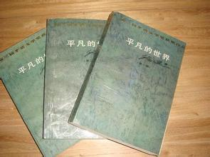
Ms. Liu
22 years ago
since 1993
Because I won a prize of English contest.
I like it very much.
I will keep it forever.

Slide 17
Pair work
A: What brings you sweet memories?
B: …
A: Who gave it to you?
B: …
A: When did he / she give it to you ?
B:When I was …/…years ago…
A: How long have you ….?
B:I have … for/since…
A:Why did he/she give you?
B:…
A:How do you like it?
B: …
A: What will you do with it?
B:…

Slide 18
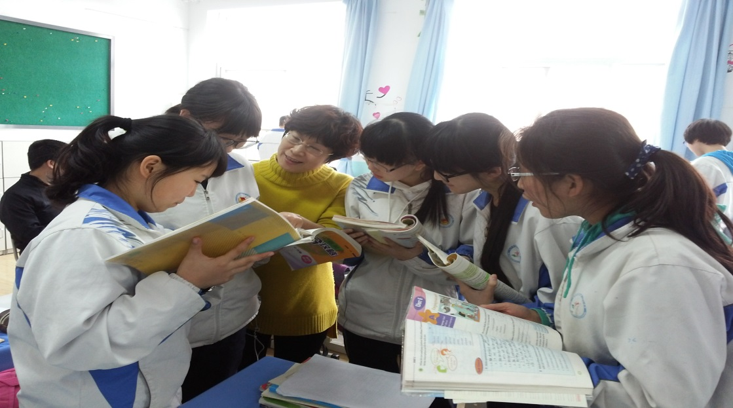
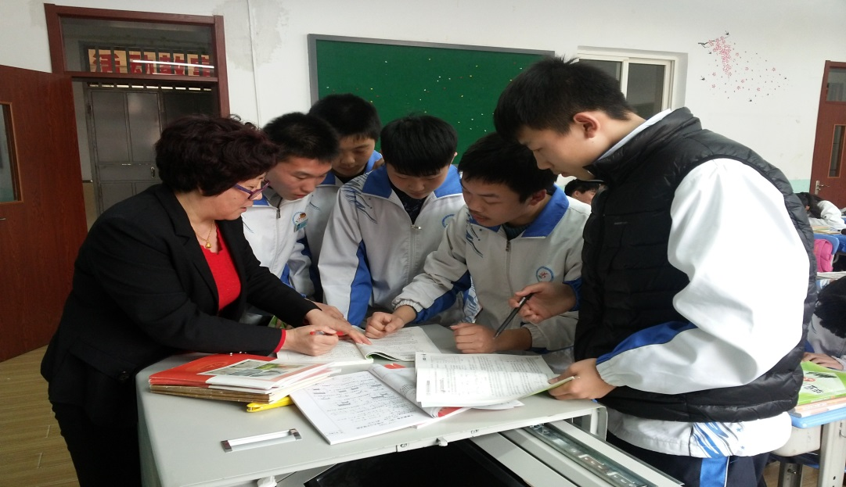
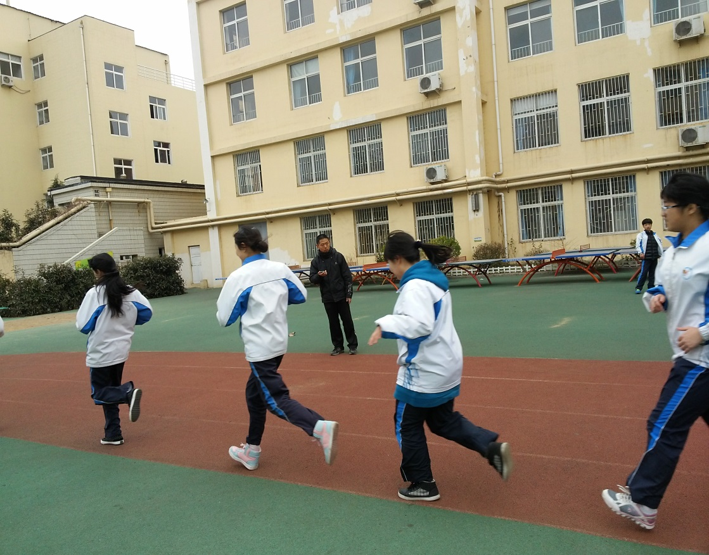
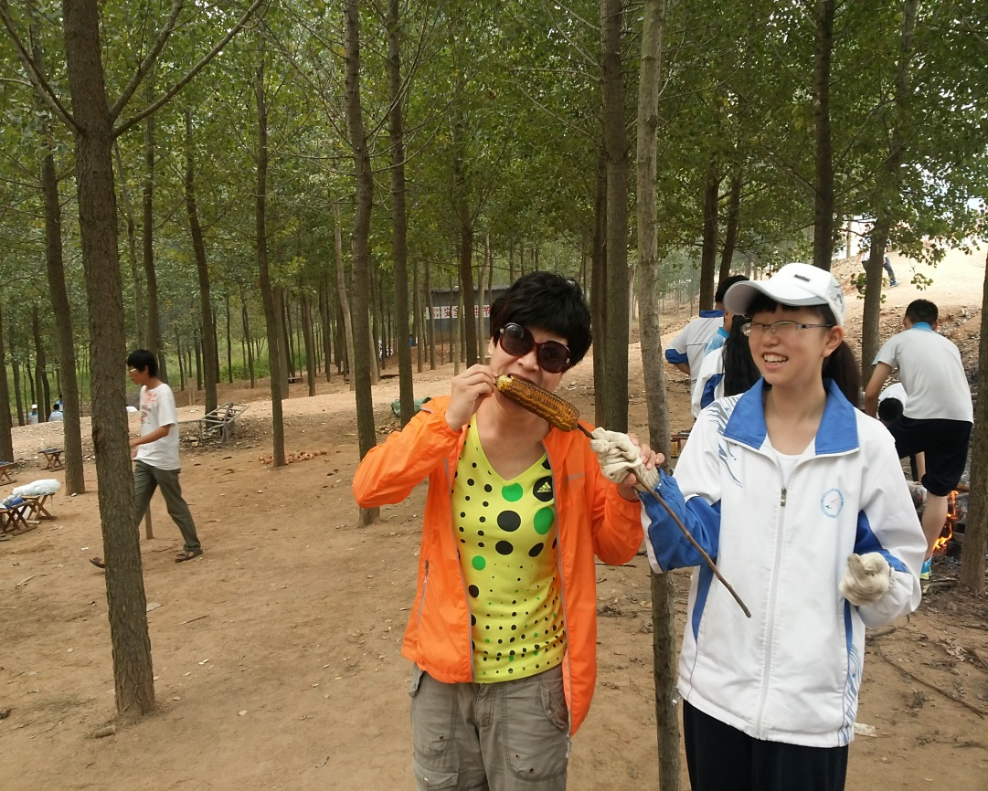

Slide 19
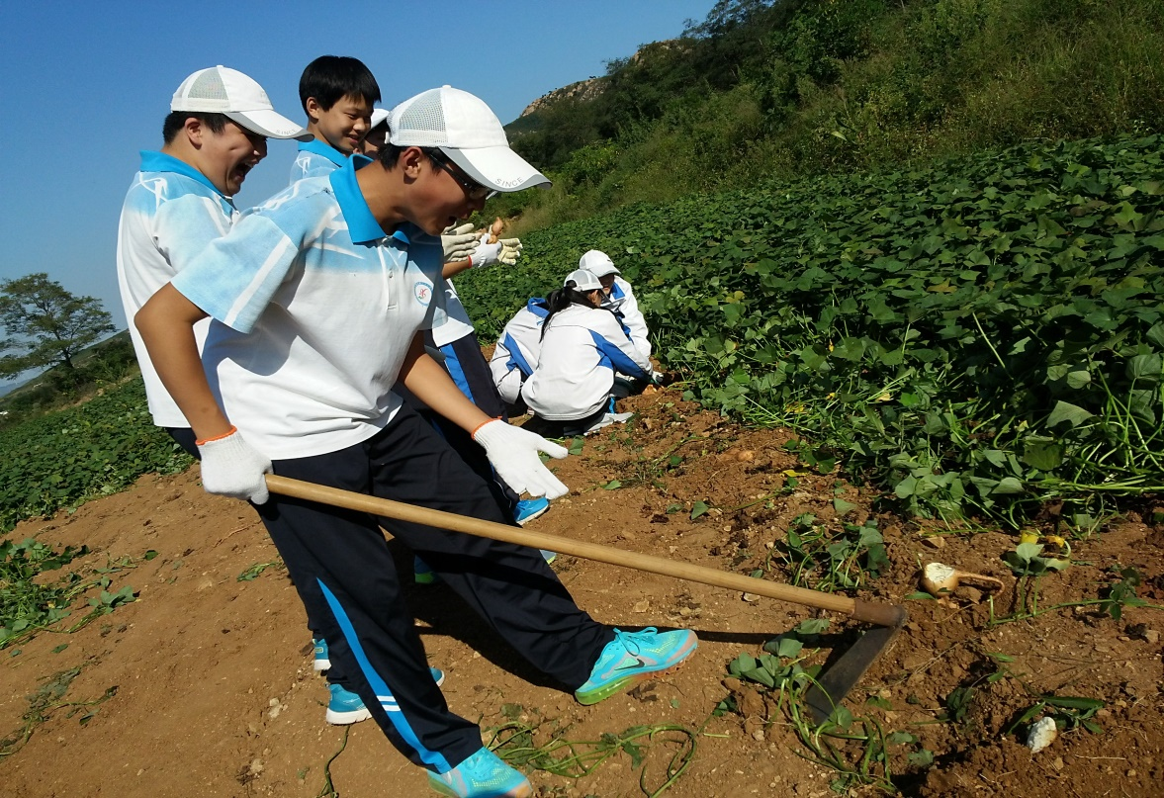
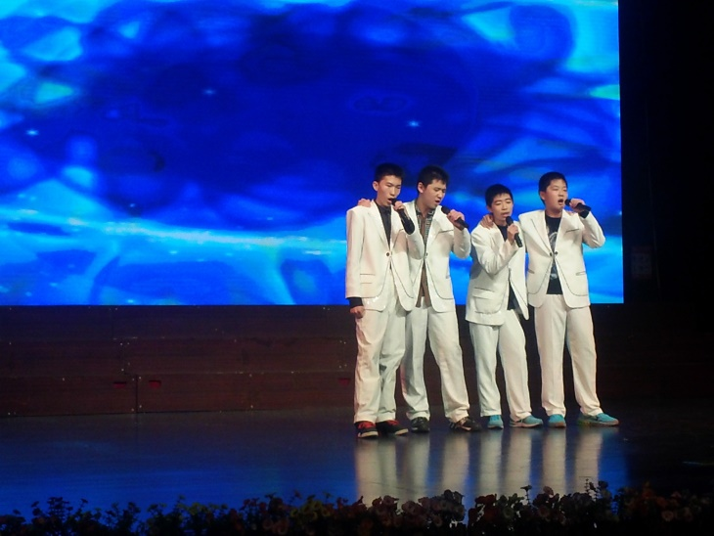
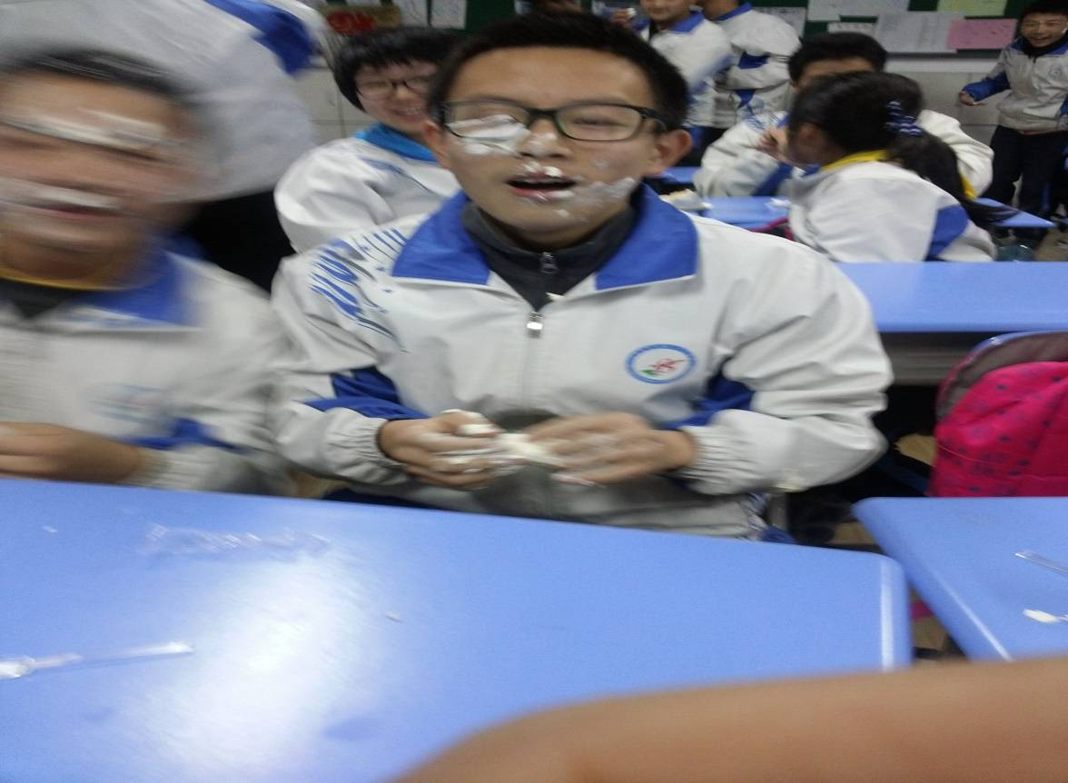
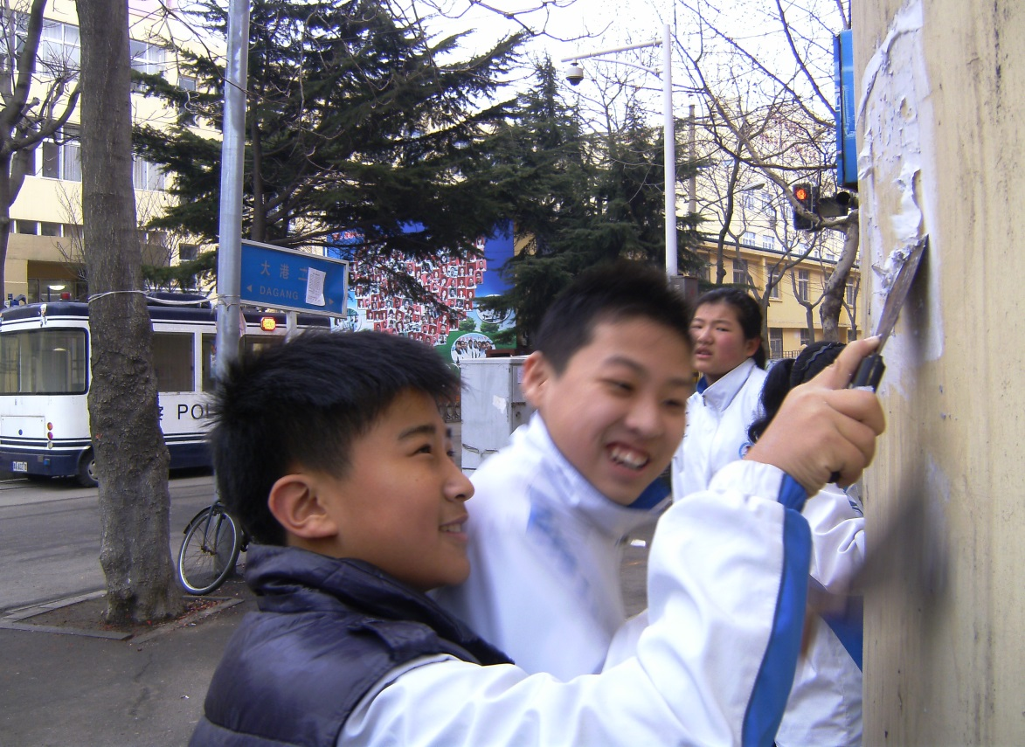
Studying Farming
Art Festival
Studying farming
New Year’s Party
Being A Volunteer

Slide 20
Art festival

Slide 21
Read this diary and fill in the missing words
since no matter how preparing for especially
a lot be thankful to a great big mess did
Jan. 28th Wednesday Sunny
I was so excited that I couldn’t fall asleep .Today I took part in the 25th art festival of our school. Jiang RenTao,
Wang Lei, Da Kai and I sang Brothers and we won the first prize. Looking back at the past several days, it has left many unforgettable memories in my heart. I remember 1_______________ the art festival, we made the classroom 2______________ . I remember 3____________ late it was, we four took the time to practice singing every day, 4________ after school. We encouraged each other to do 5_____ better. Not only 6 ____ Ms.Yu guide us how to perform well, but she helped us to overcome
preparing for
a great big mess
no matter how
especially
a lot
did

Slide 22
since
the fear. I remember 7_____ we decided to take part in the performance, our lovely classmates have tried their best to help us. With their help, finally we kept our cool and won the first prize. Thanks to the caring people around me, I won’t be scared of performing in public anymore. To 8________________ them, I will try my best to get best grades. I will remember this day forever wherever Iａｍ.
be thankful to

Slide 23
Jan. 28th Friday Sunny
I was so excited that I couldn’t fall asleep. Today I took part in the 25th art festival of our school. Jiang RenTao, Wang Lei, Da Kai and I sang Brothers and we won the first prize. Looking back at the past several days, it has left many unforgettable memories in my heart. I remember preparing for the art festival, we made the classroom a great big mess. I remember no matter how late it was, we four took the time to practice singing every day, especially after school. We encouraged each other to do a lot better. Not only did Ms.Yu guide us how to perform well, but she helped us to overcome the fear.
Jiang RenTao, Wang Lei, Da Kai and I sang Brothers and we won the first prize.
we made the classroom a great big mess. I remember no matter how late it was, we four took the time to practice singing every day, especially after school.
Ms.Yu guide us how to perform well, but she helped us to overcome the fear.

Slide 24
I remember since we decided to took part in the performance, our lovely classmates have tried their best to help us. With their help, finally we kept our cool and won the first prize. Thanks to the caring people around me, I won’t be scared of performing in public anymore. To be thankful to them, I’ll try my best to get best grades. I will remember this day forever wherever I am!
our lovely classmates have tried their best to help us.
I won’t be scared of performing in public anymore. To be thankful to them, I’ll try my best to get best grades. I will remember this day forever wherever I am!

Slide 25
Do a survey according to the mind map
school memories
 | objects | persons | events influence
possession |  |  | be not good at , be patient with , take time to explain,
person
experience
a book
Ms. Liu
thanks to
her,
put in more effort,
scores
doubled

Slide 26
Do a survey according to the mind map
school memories
 | objects | persons | events influence
possession
person
experience

Slide 27
初三季，毕业季，我们就要离开生活了三年的美丽校园， 回首过去，你的人生一定留下了很多美好回忆， 我们一起用英语写一篇短文，包括以下要点：
1.简要描述让你难忘的物品、经历或者人。
2. 记述发生在你们之间的故事。
3. 这个物品、经历或人对你的影响。
要求：1.字数（80-100），开头已给出，不计入总字数。
2.文中不得出现真实的校名和人名。
Looking back at these past three years _______________
__________________________________________________
____________________________________________________________________________________________________
Writing

Slide 28
Homework:
until
time explaining to me ______I understood completely.Thanks _____ them, I’ ve become interested in English and I’m good at it now! I’m so lucky to be a member of them. I think we should be thankful to the important people in our lives who helped and _________ us ---- our parents, our teachers and our friends. From now on, I’ll try to help others when they are in trouble. Now it’s time to say goodbye. I will remember my life in junior high school forever.
to
Memorize the phrases and sentence patterns in the chart.
Finish the exercises on the learning paper.
Finish the passage about school memories.
supported

Slide 29
Time flies while memories last forever!
until
time explaining to me ______I understood completely.Thanks _____ them, I’ ve become interested in English and I’m good at it now! I’m so lucky to be a member of them. I think we should be thankful to the important people in our lives who helped and _________ us ---- our parents, our teachers and our friends. From now on, I’ll try to help others when they are in trouble. Now it’s time to say goodbye. I will remember my life in junior high school forever.
to
supported
Thanks for listening!

Slide 30
Summary:
until
time explaining to me ______I understood completely.Thanks _____ them, I’ ve become interested in English and I’m good at it now! I’m so lucky to be a member of them. I think we should be thankful to the important people in our lives who helped and _________ us ---- our parents, our teachers and our friends. From now on, I’ll try to help others when they are in trouble. Now it’s time to say goodbye. I will remember my life in junior high school forever.
persons
to
supported
School Memories
experiences
possessions

