Slide 1
Unit 8 How do you make a banana milk shake?
Section B 2a-2e
No. 61 Middle School
Liu Kaikun

Slide 2
Read quickly and answer the questions.
1. What’s the article about?
Thanksgiving.
2. What’s the main dish of the
meal?
Turkey.

Slide 3
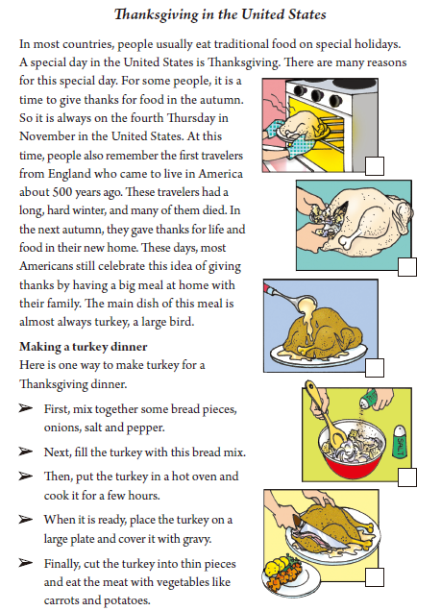
Strategy:
Pay attention to the title and pictures.

Slide 4
Read Part 1 and answer the questions.
1. Where do people celebrate
Thanksgiving?
2. When do people celebrate it?
3. Why did people celebrate it?
4. How do people celebrate it
now?

Slide 5
1. Where do people celebrate
Thanksgiving?
2. When do people celebrate it?
In the United States.
On the fourth Thursday in November.

Slide 6
3. Why did people celebrate it?
4. How do people celebrate it
now?
Because the travelers wanted to give thanks for life and food in their new home.
By having a big meal at home with their family.

Slide 7
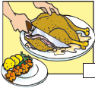
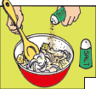
Read Part 2 and use sentences to describe the pictures.

Slide 8
Put the turkey in a hot oven and cook it for a few hours.
Fill the turkey with this bread mix.
Place the turkey on a large plate and cover it with gravy.
Cut the turkey into thin pieces and eat the meat with vegetables like carrots and potatoes.
Mix together some bread pieces, onions, salt and pepper.

Slide 9
How to make a Turkey.
First,
mix ….pepper.
Next,
fill …with ...
Then,
put …in a hot oven and …
place … on a large plate and cover it with gravy.
……
Finally,
cut …into …and eat ..

Slide 10
Group work
Special days in China.

Slide 11
Show Time

Slide 12
Summary
1. Words and phrases.
2. How to make things.
First,….Next,….Then,….Finally,….

Slide 13
Homework
Write an article about a special day in China and how to make the main dish of this day.

Slide 14
Thank you for your listening!
Goodbye!

