Slide 1
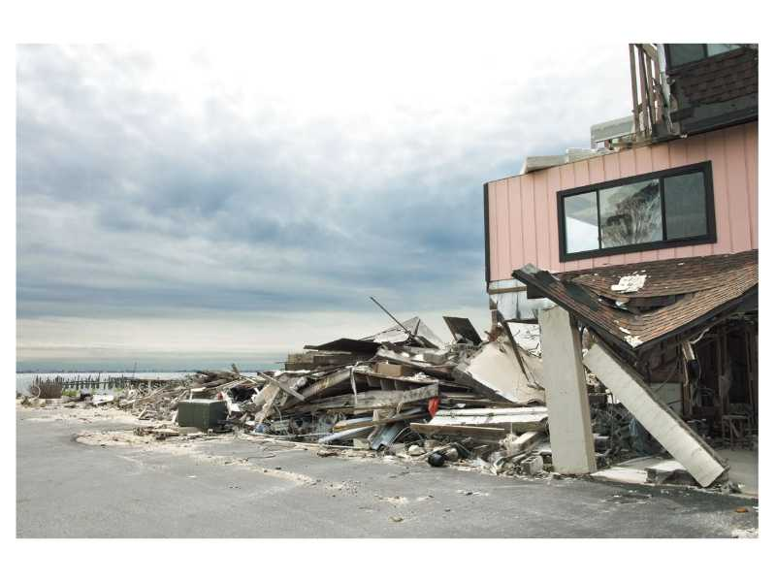
The Storm Brought
People Closer Together
青岛第五十一中学
管婧安

Slide 2

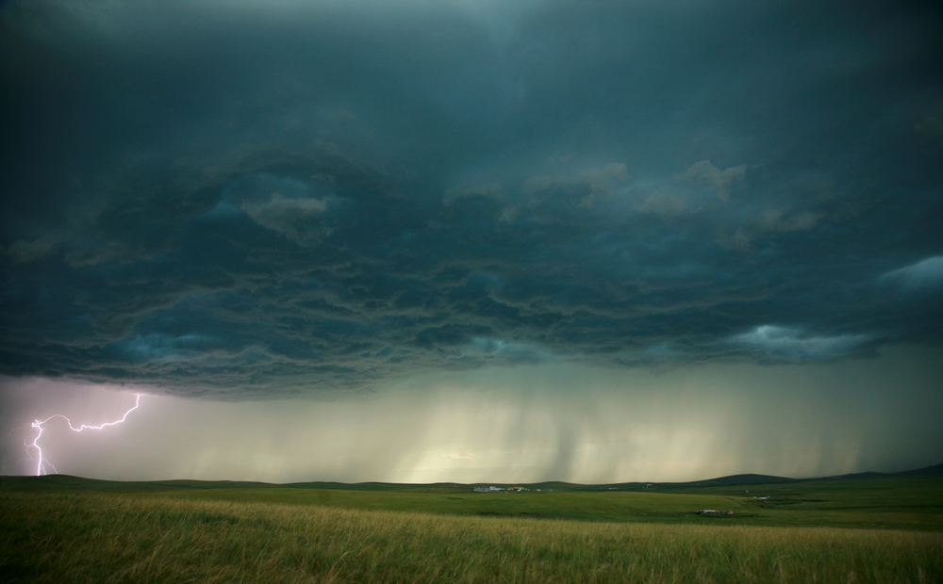
What's the video about?
What can you see in the video?

Slide 3

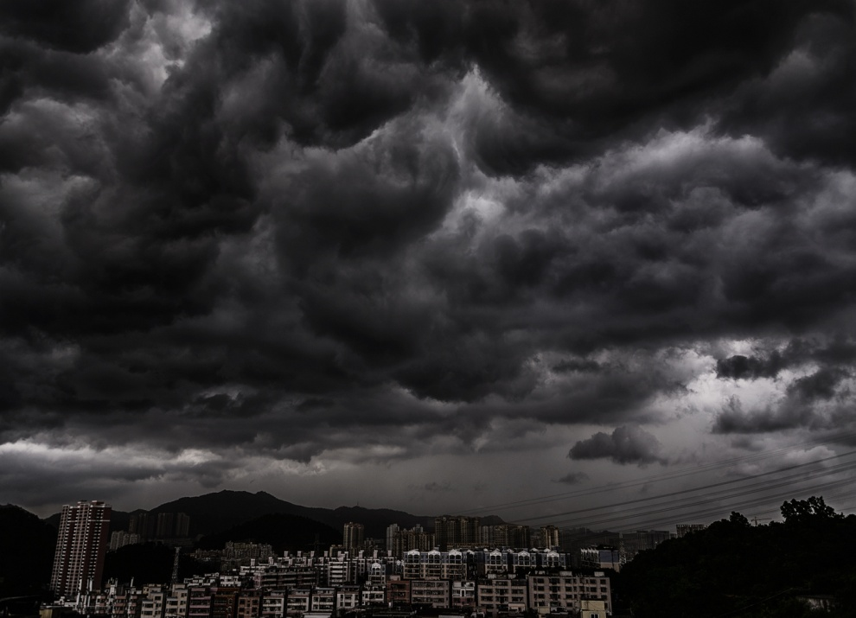
black clouds
no light
midnight

Slide 4
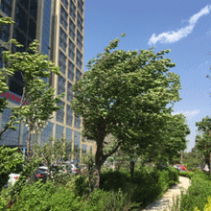
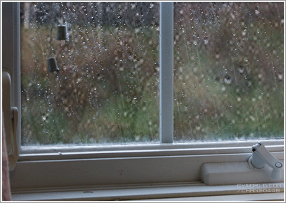
Strong winds are blowing.
blow v. 吹，风吹
The rain beats heavily against the windows.

Slide 5




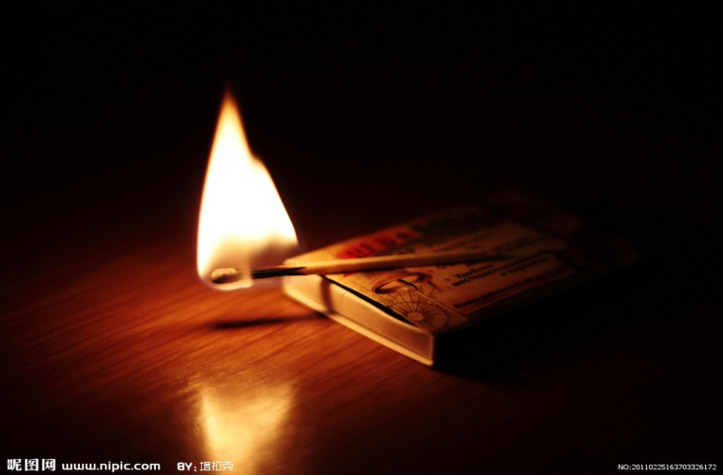
candles
flashlights
the electricity may be turned off
matches

Slide 6
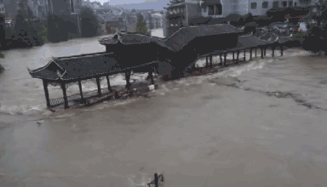
break things apart
adv. 分离，分开

Slide 7
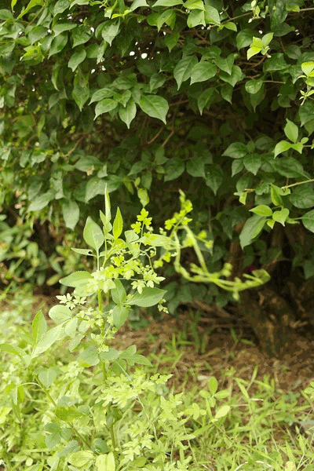
die down 逐渐变弱，逐渐消失

Slide 8
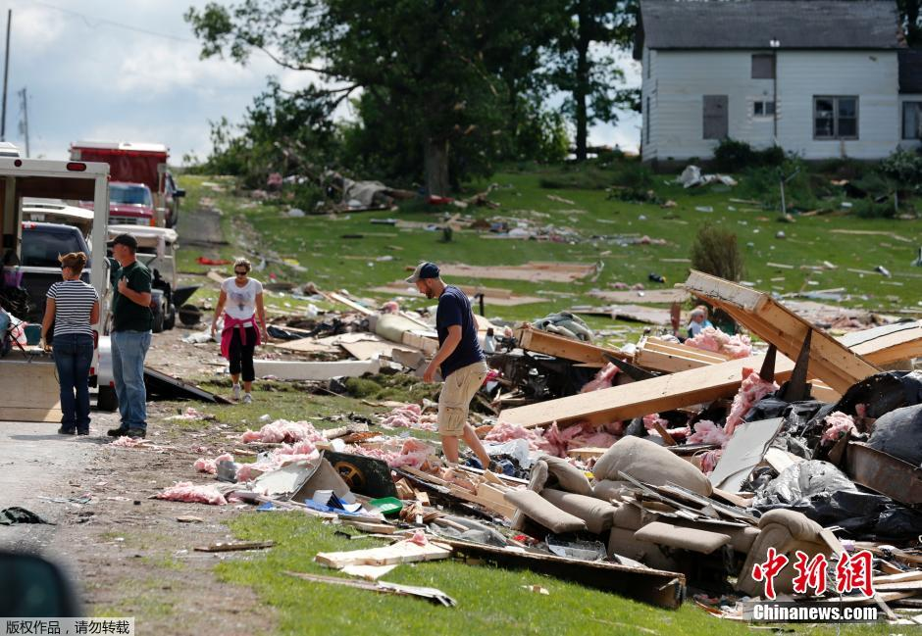
broken windows
fallen trees
in a mess
rubbish

Slide 9
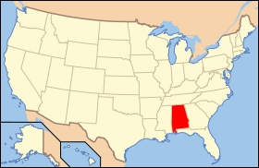
Alabama
亚拉巴马州（美国）

Slide 10

Skim the passage and match the main ideas with the paragraphs.
Para.1
before the storm
Para.2
during the storm
Para.3
after the storm
Para.4

Slide 11
Read the passage again and answer the questions.
1. What was the weather like before the
heavy rain started?
2. What was the neighborhood like after the
storm?
Strong winds were blowing outside.
Black clouds were making the sky very
dark.
The neighborhood was in a mess.

Slide 12
Task 1 Read Para 1&2 and fill in the blanks
Before the storm
a heavy
rainstorm
______winds
strong
_________
was in the area
environment
______clouds
black
______ light
no
Dad____________pieces of wood over the windows.
was putting
people’s
activities
was making sure the _______
and _______ were working.
flashlights
Mom
radio
put some ______ and _______ on the table
candles
matches

Slide 13
Task 2 Read Para 3 and fill in the blanks
During the storm
Ben __________ his mom ___________
when the rain began to _____________ against the windows.
was helping
make dinner
beat heavily
Ben’s family tried to______________, but it was ______________ with
_____________happening outside.
play a card game
hard to have fun
a serious storm

Slide 14
Task 3 Read Para 4 and fill in the blanks
After the storm
The sun_________
was rising
environment
Neighborhood:____________
in a mess
______
trees
fallen
_______
windows
________
broken
rubbish
people’s activities:__________________
help clean up…together
feeling: Although the storm_____________________, it ________ families and neighbors ________________.
broke many things
apart
closer
together
brought

Slide 15
Please read Para 1.2&3 with
the recording.
Please read the last paragraph after the recording.
Please read the whole passage
aloud by yourselves.

Slide 16
3b Complete the sentences using
information from the passage.
1. When the news on TV was reported,
strong winds ____________ outside.
2. While Ben’s mom was making sure the radio was working, his dad __________________________________________
were blowing
was putting pieces of wood over the windows.

Slide 17
3. Ben ____________________________ when the heavy rain finally started.
4. When Ben ___________ at 3:00 a.m.,
the wind ______________.
was helping his mom make dinner
fell asleep
was dying down

Slide 18

Storm

Slide 19
1 | 2 | 3 | 4
5 | 6 | 7 | 8
9 | 10 | 11 | 12

Slide 20

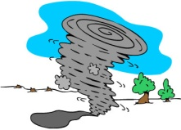

Key
=One point for your team
=Two points for your team
=Three points for your team
=Four points for your team
=lose all the points of your team
=other team(s) lose all the points
=take all the points from the team you like
.

Slide 21

1 | 2 | 3 | 4
5 | 6 | 7 | 8
9 | 10 | 11 | 12

Slide 22
After the rainstorm, the neighborhood was _________. __________, ______________ and rubbish were everywhere.
in a mess
fallen trees
broken windows

Slide 23
What was Ben’s mother doing before
the storm?
She was making sure the flashlights and radio were working. She also put some candles and matches on the table.

Slide 24
What did Ben’s family do after dinner?
Did they have fun?
Why?
They played a card game.
No, they didin't.
Because it was hard to have fun with a
serious storm happening outside.

Slide 25
Where did this story happen?
It happened in Alabama.

Slide 26
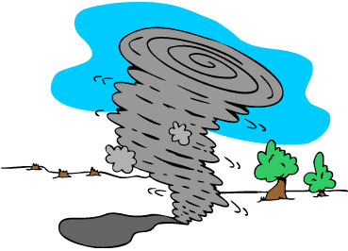
Before the storm, strong winds
__________________ outside.
____________were making the sky very
dark.
___________________________, it
felt like midnight.
were blowing
Black clouds
With no light outside

Slide 27
Ben fell asleep when the wind
was _____________ at around 3:00 a.m.
dying down

Slide 28
When the rain started to beat the
windows, what was Ben doing?
He was helping his mother make dinner.

Slide 29
What was Ben’s father doing before
the storm?
He was putting pieces of wood over the
windows.

Slide 30
When Ben woke up, the sun
________________.
was rising.

Slide 31
What did Ben’s family do after
the rainstorm?
They joined the neighbors to help clean
up the neighborhood together.

Slide 32
Although the storm __________________, it _________________________________________.
broke many things apart
brought families and
neighbors closer together

Slide 33
Before the rain started,the
TV news reported that
_________________________.
a heavy rainstorm was in the area

Slide 34

Free talk
What other disasters(灾难) can bring people closer
together?

Slide 35
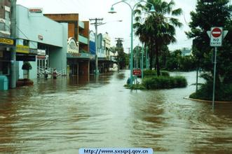
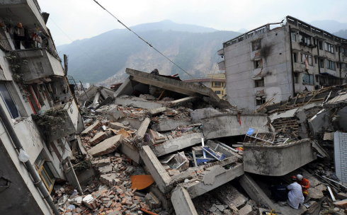
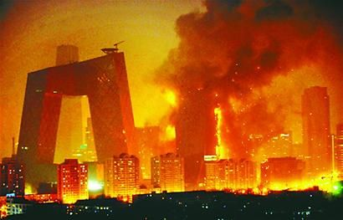
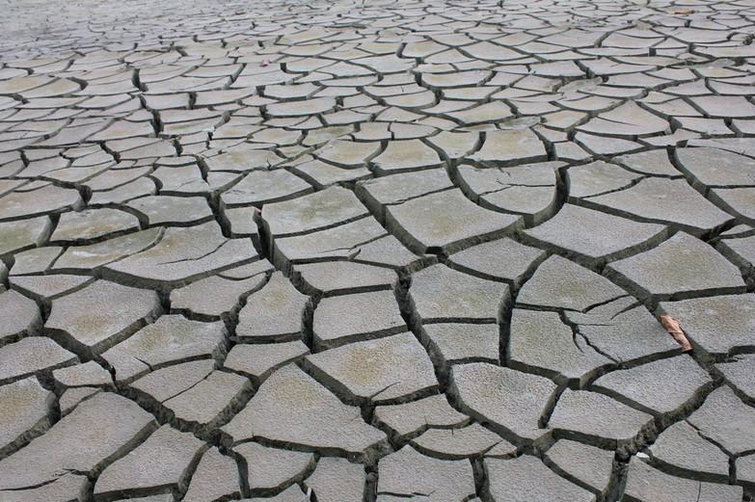
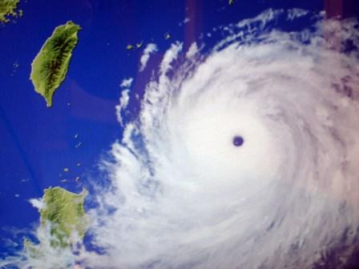
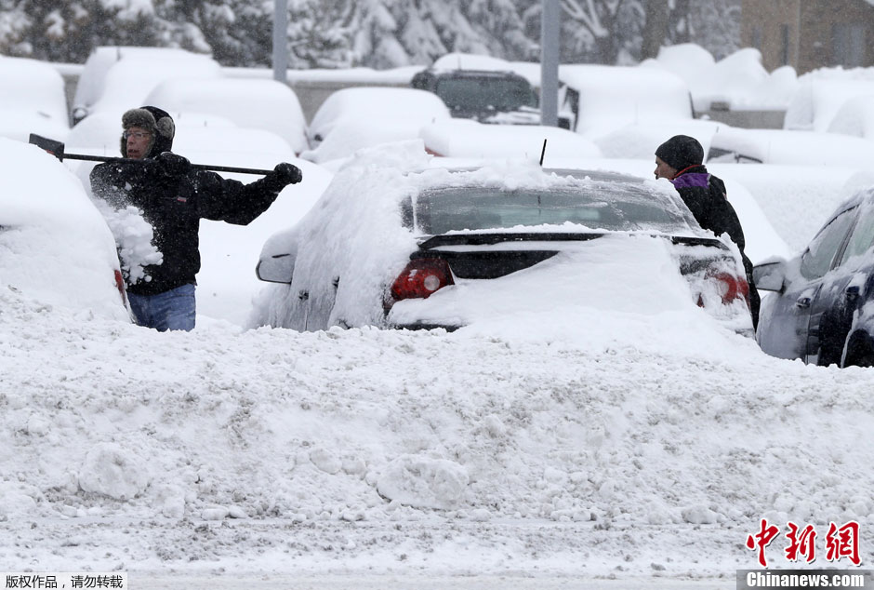
flood
earthquake
fire disaster
Protect ourselves
Disasters can
bring us closer together
…
…
Help each other
…
drought
typhoon
snowstorm

Slide 36
Make posters
How can we help each other in times of difficulty?
Please work in groups and make some posters.
You will have 5 minutes.
useful phrases:
cheer up give away
help...do clean up
volunteer to ... share...

Slide 37
Enjoy our posters!

Slide 38

If you light a lamp for somebody, it will also brighten your path.
为别人点一盏灯，照亮别人，也照亮了自己。

Slide 39

Homework
All students:
Read the passage aloud.
Make at least 5 sentences by using the
key points of this class.
Optional homework
Search more information about how to help people in difficulties in right ways.

Slide 40


