Slide 1

storm

Slide 2
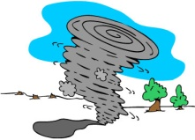

Key
= One point for your team
= Two points for your team
= Three points for your team
= Four points for your team
= All points lost for your team
= All points lost for other team(s).
= All points stolen from 1 team
.

Slide 3
A | B | C | D
E | F | G | H
I | J | K | L
M | N | O | P
Q | R | S | T

Slide 4

What 's this in English ?

Slide 5

What's this in English?

Slide 6

What are these in English?

Slide 7
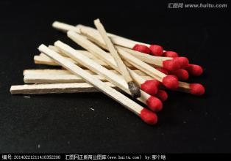
What are these in English?

Slide 8

What 's this in English?

Slide 9
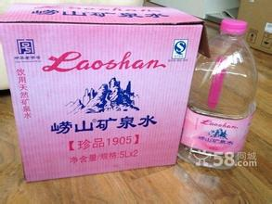
What's this?

Slide 10

What 's this in English?

Slide 11

What 's this in English?

Slide 12
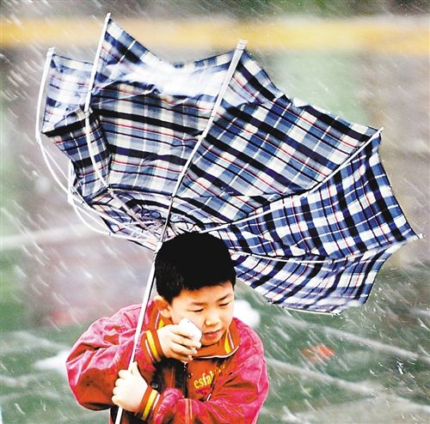
strong _______

Slide 13
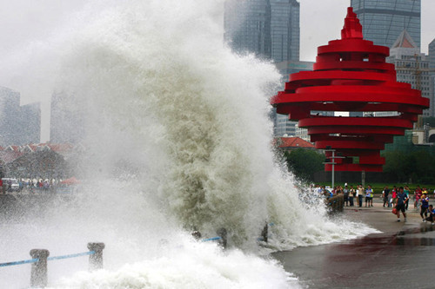
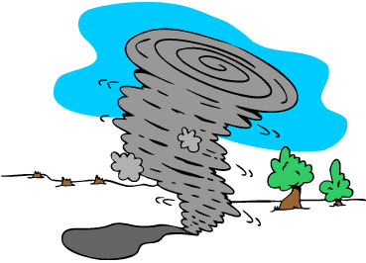
What was the weather like?

Slide 14
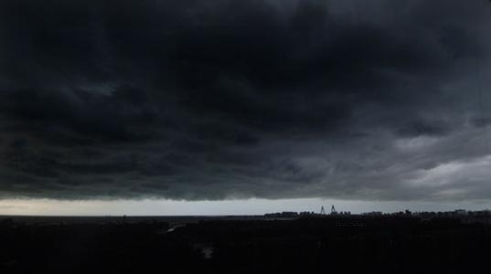
What was the weather like?
black___________

Slide 15
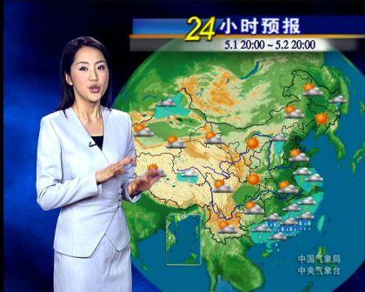
What does the woman do?

Slide 16

What's this in English ?

Slide 17

The sun was______________.

Slide 18
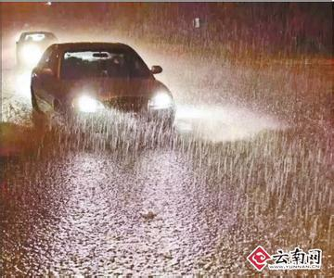
What was the weather like?
heavy________

Slide 19
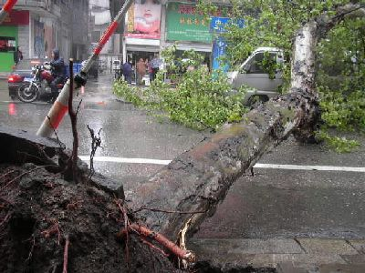
What 's the matter with the tree?

Slide 20

What was he doing?

Slide 21
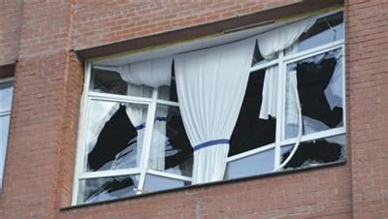
What was the matter with the windows?

Slide 22
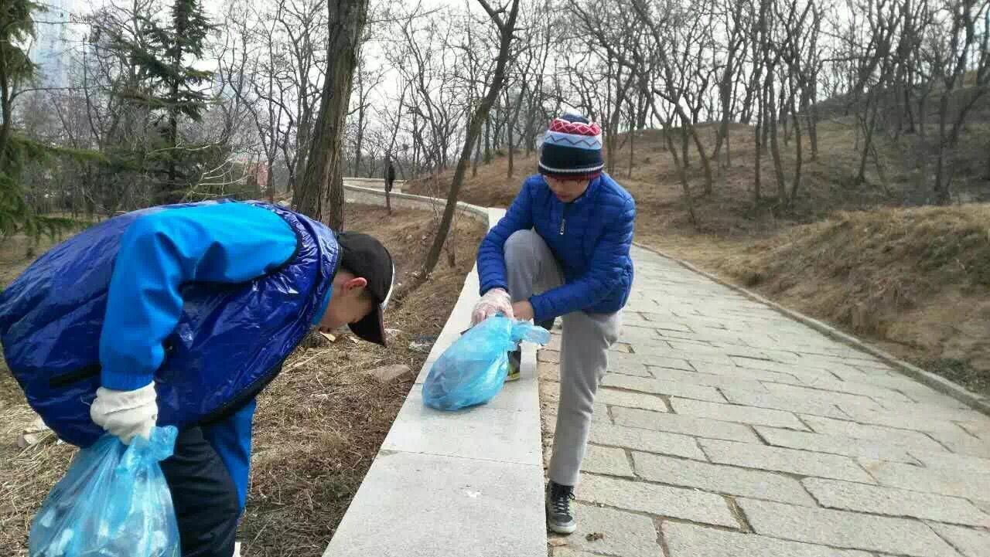
What were they doing?

Slide 23

What was the picture about?

